Slide 1
Developing Resilient Congregations in a Changing Environment
David Brubaker
Center for Justice and Peacebuilding
Eastern Mennonite University

Slide 2
Introduction
Raised in a Pastor’s Home
Work with Mennonite Conciliation Service (1986-1988)--first congregational case in 1987
My greatest education in change and conflict awareness has come from….

Slide 3
Congregations as Systems
Congregations are both social and emotional systems.
As social systems, they consist of a unique structure and a discrete culture, nested in a particular set of environments.
As emotional systems, they include relational connections, emotional patterns, and established habits that are difficult to change.

Slide 4
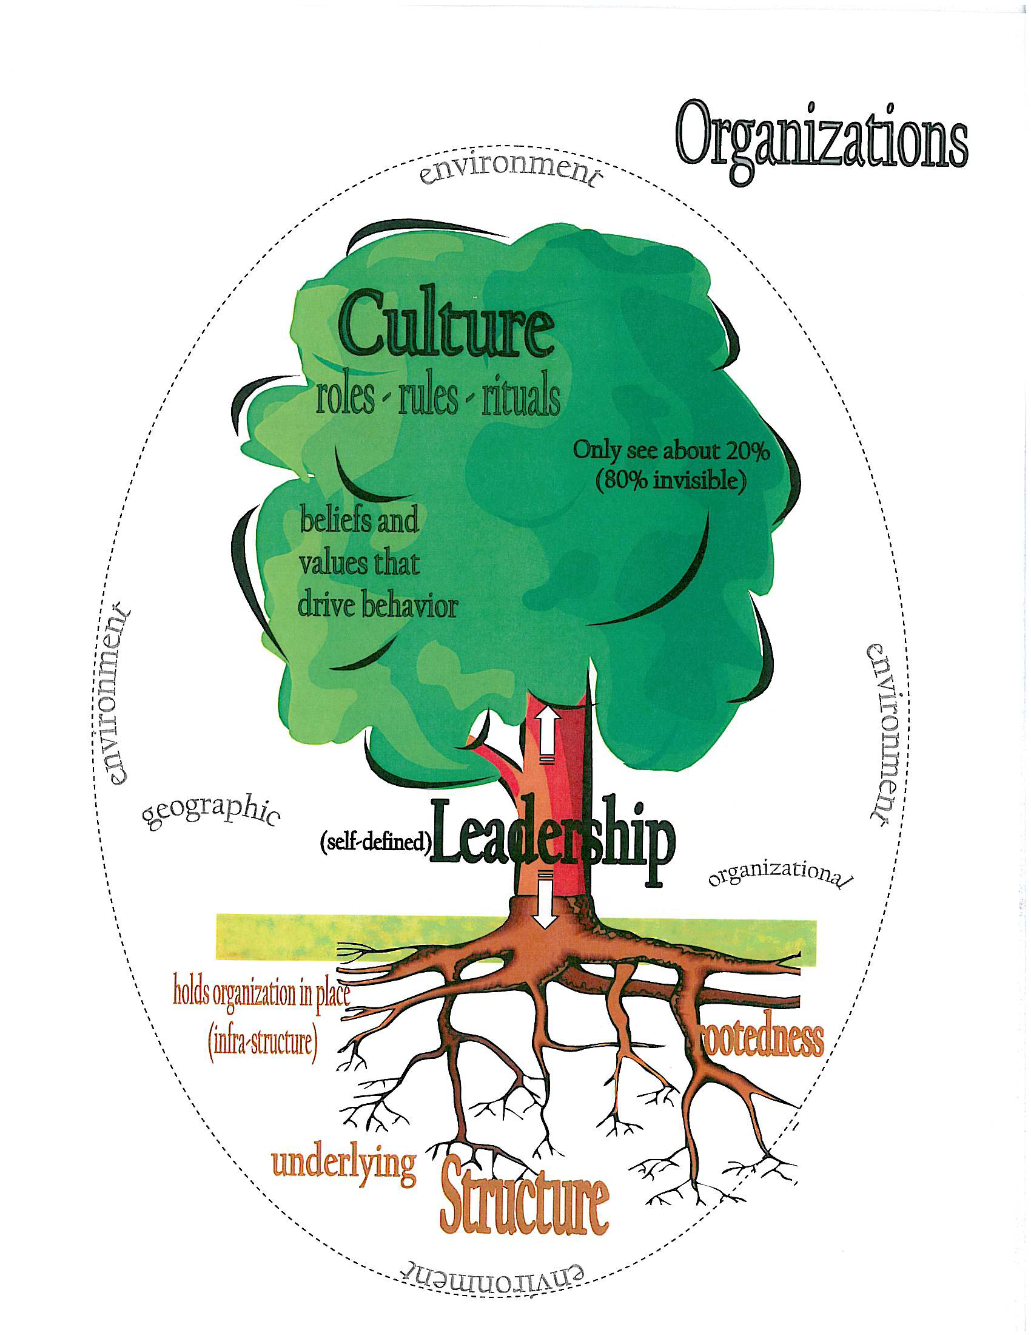

Slide 5
Congregational Structure

Slide 6
Leadership in Congregations
Those at the top of the organizational structure are the formal leaders; informal leaders may appear at any level of the system.
Leaders have the most leverage to introduce or forestall change within the system, in part through the planning and budgeting cycle.
Leaders also have a symbolic role in congregations. When things are going well they are praised, when things go poorly they are blamed (and sometimes fired.)
The functioning of top congregational leaders (both lay and clergy) is the most critical factor in congregational transformation.

Slide 7
Congregational Culture
Congregational culture is like an iceberg
The visible part consists
of rituals and artifacts that
are apparent even to outsiders.
Less visible are the norms and
values that lie just below the
surface. Even further down are
the beliefs and assumptions that
produce the values, rituals and
artifacts. These are the hardest
to change, and even to identify.

Slide 8
Congregational Environment
Although a congregation can
change its structure and transform
its culture, it has less control over
its environments (social, political,
economic). Healthy congregations
monitor their environments, and
make proactive adaptations to be
successful in those environments.

Slide 9
For Discussion
What two or three changes in your congregation’s multiple environments (social, political, economic, technological) have had the greatest effect on your congregation the last five to 10 years?
What specific changes were introduced to your congregation as it adapted to these changes in its environment?
Did conflict occur within the congregation due to these changes? If so, how did the conflict(s) impact the congregation?

Slide 10
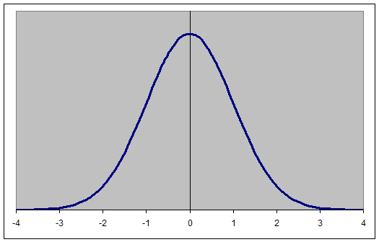
Change Dynamics in Congregations
Resistance to change is not “bad”—it’s normal.
Congregations need “agents of stability” as well as “agents of change.”
The key group is the “critical middle”

Slide 11
Managing Change: The Leader’s Role
Leaders need to articulate a clear vision (ends) while being flexible on how to get there (means)
Leaders must build a coalition that shares that vision (“coach a team”)
Leaders have to allow time for the change process to unfold
Leaders need to nest the proposed change in the congregation’s culture (establish legitimacy)

Slide 12
Leader’s Self-Management
Managing change or conflict starts with managing oneself.
Successful change agents learn the culture of the congregation (“earn the right to make change”)
A leader’s ability to absorb the pain, uncertainty and anxiety of change and conflict may be the most critical variable in successful change.

Slide 13
“Where There’s Change There’s Conflict”
Not all change produces conflict
Process (how the change is done) often matters more than Outcome (what is done)
Changes to a congregation’s Structure or Culture are particularly likely to produce conflict (changes to both make congregational conflict seven times more likely)
Key is to anticipate and normalize the conflict, and to invite disagreement. (Move towards the resistance and engage it, as the apostles did in Acts 6.)

Slide 14
For Discussion
Think of a time when a conflict occurred in your congregation, your family or your workplace (between individuals or between groups) that had either a positive or a negative outcome.
Think about the process that was used to address that particular conflict.
What was it about the process that contributed to the positive or negative outcome?

Slide 15
Resources
The Hidden Lives of Congregations: Discerning Church Dynamics, by Israel Galindo (Alban, 2004).
Promise and Peril: Understanding and Managing Change and Conflict in Congregations, by David Brubaker (Alban, 2009).
Center for Justice and Peacebuilding: www.emu.edu/cjp
david.brubaker@emu.edu

